Slide 1



Two types of crop production in India – A case study and detailed data analysis
Presented by
Papu Mahanta
Sem-Vi , Roll no- B.Sc.(Sem-Vi) Stat-07
Department of Statistics, Visva-Bharati University
Notes:
Intro :- Good afternoon to the respected teachers, I'm Papu Mahanta and today I'm going to discuss my project which is on the Crop Production of India

Slide 2
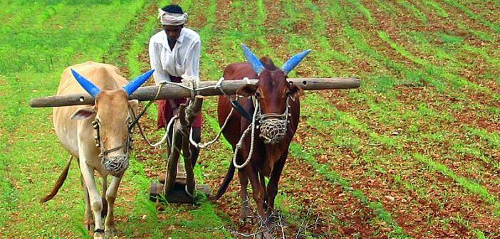









Contents
Introduction
Data Source
Data Description
Descriptive Analysis:
Statistical Tools and Techniques
Statistical Analysis
Conclusion & References
Notes:
First of all these are the contents of my project

Slide 3

Introduction:
In India, agriculture is the backbone of the economy, and it is the primary source of livelihood for a majority of the population. India has a diverse climate, which allows for two crop seasons, Kharif and Rabi.
Kharif is the summer crop season, which starts in June and ends in October. It is also known as the monsoon season, as it is heavily reliant on rainfall.
On the other hand, Rabi is the winter crop season, which starts in October and ends in March. Rabi crops are sown after the monsoon season and rely on irrigation.
Kharif crops in India :-
Rice, Millet, Cotton, Sugarcane, Groundnut, Soybean, Moong dal
Rabi crops in India :-
Wheat, Barley, Mustard, Peas, Lentil, Rapeseed, Cumin
Notes:
As we all know in India, agriculture is the backbone of the economy,,
India has a diverse climate, which allows for two crop seasons , i.e.Kharif and rabi

Slide 4
DATA DESCRIPTION
My data is about agriculture land use, production, Productivity of crop and percentage coverage under irrigation. It’s a time series data. My data given below. We collect the data from year 1962 to 2021. Here we have considered two types of crops, kharif and rabi.
Data source:- ://www.indiastat.com/table/agriculture/season-wise-area-production-productivity-rice-indi/7264
Area
Irrigation
Year
https
productivity
Production
C:/Users/USER/OneDrive/Desktop/PROJECT/crop production in india.csv
Notes:
....My data is about ....kharif and rabi And here I have mentioned the data source from where I have collected my data

Slide 5

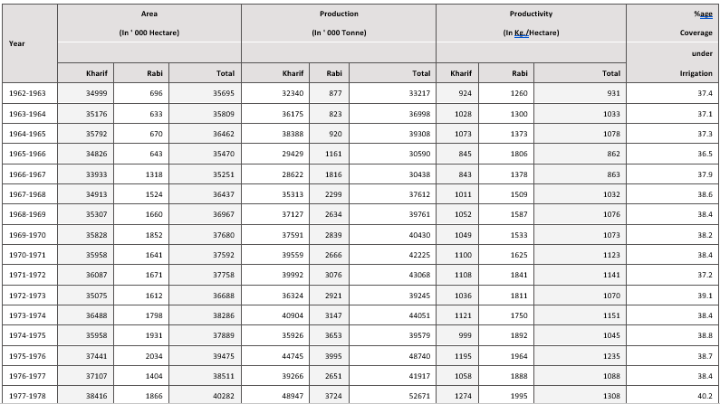
In this slide we have shown the first part of the data which we have analyzed to prepare our report:-

Slide 6
Objective
1. Analysis Trend by Moving Average
2. Autocorrelation and partial autocorrelation function
3. Model fitting
4. Forecasting
5. Simple Regression on total productivity and
percentage coverage under irrigation
Notes:
6. Here are the objectives of our presentation

Slide 7

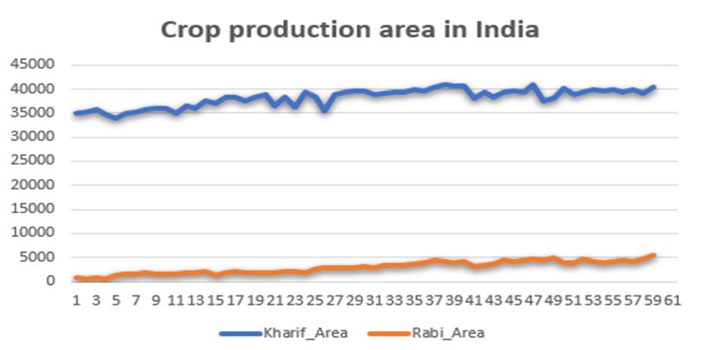
Descriptive Analysis:-
Diagrams like graphs, charts, maps, pictures etc. are attractive and effective means for presentation of statistical data. It is more effective than tabular representation, being easily intelligible to a layman.
Line Diagram:
INTERPRETATION- The following line graphs shows that the kharif production area is constant with respect to time but Rabi crop production area is slightly increasing with respect to time.
Notes:
7. Here we have prepared some graphical representation of the data ,like line diagram , bar diagram and pie chart

Slide 8
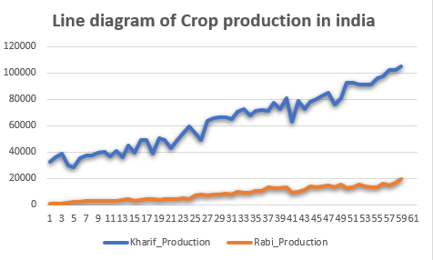
INTERPRETATION- - From the graphical representation of Crop production in INDIA we can see that the Kharif Crop production in INDIA is gradually increasing with respect to time. AS long as time is increasing production of kharif and Rabi crop is also increasing.

Slide 9
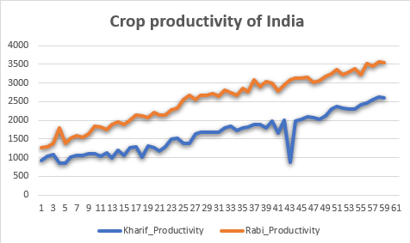
INTERPRETATION- From this diagram of Crop productivity in INDIA we can see that the Kharif Crop productivity in INDIA is gradually increasing with respect to time. AS long as time is increasing productivity of kharif and Rabi crop is also increasing.

Slide 10
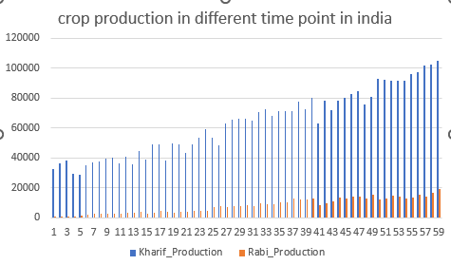
ii. Bar Diagram: Another mode of diagrammatic representation of data is the use of bar diagrams.
→INTERPRETATION- - Following ber graphs shows that the Crop production in INDIA is gradually increasing with respect to time. AS long as time is increasing production of kharif and Rabi crop is also increasing.

Slide 11
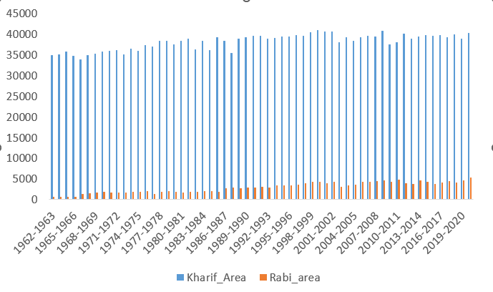
CROP PRODUCTION AREA IN INDIA
INTERPRETATION- From the graphical representation of Crop production area in INDIA we can see that the Kharif Crop production area in INDIA is constant with respect to time but Rabi crop production area is slightly increasing with respect to time.

Slide 12

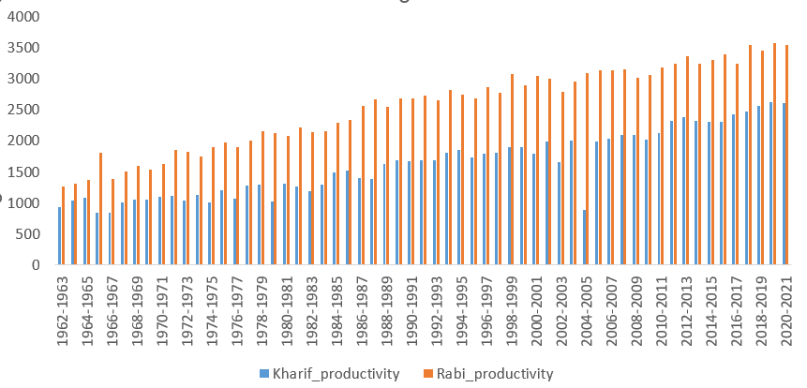
CROP PRODUCTIVITY IN INDIA
INTERPRETATION- - From the ber graph we have found that the Crop productivity in INDIA is gradually increasing with respect to time. AS long as time is increasing productivity of kharif and Rabi crop is also increasing.

Slide 13
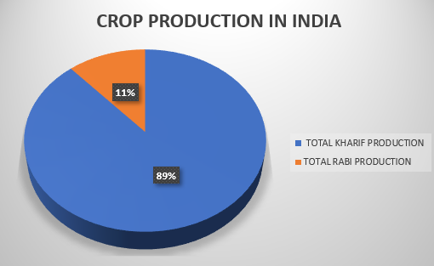
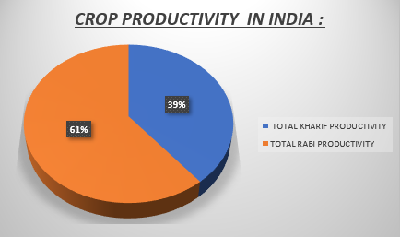
iii. Pie diagram: A pie chart is an appropriate diagram used for exhibiting the relative sizes of the different parts of a whole.
INTERPRETATION- - The following pie graph shows that 11%is the Rabi and 89% is the Kharif production out of the total average crop production of 60 years.
INTERPRETATION - - Here we see that 61% is the Rabi and 39% is the Kharif productivity out of the total average crop productivity of 60 years.
Notes:
13. Here we have prepared two pie graphs ...first one shows the crop production in India ....which shows that .......The second one shows the crop productivity in India . Here we can see that .....

Slide 14


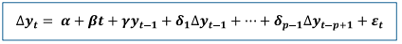

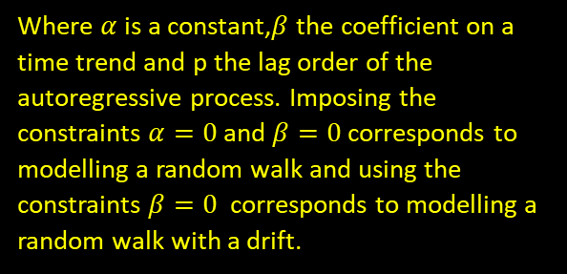
Statistical Tools and Techniques
. Augmented Dickey Fuller test (ADF Test):
Augmented Dickey Fuller test (ADF Test) is a common statistical test used to test whether a given Time series is stationary or not. It is one of the most commonly used statistical test when it comes to analysing the stationary of a series. Here, the null hypothesis that a unit root is present in a time series sample i.e. The time series is non-stationary. The alternative hypothesis the time series is stationary.
The testing procedure for ADF test is the same as for the Dickey Fuller test but it is applied to the model-
Where $α$is a constant,$β$ the coefficient on a time trend and p the lag order of the autoregressive process. Imposing the constraints $α=0$and $β=0$corresponds to modelling a random walk and using the constraints $β=0$ corresponds to modelling a random walk with a drift.
By including lags of the order p the ADF formulation allows for higher-order autoregressive processes.
Notes:
14. Here we have used ADF test to test whether the given time series data is stationary or not..and it's applied to the following model

Slide 15

Data analysis
Augmented Dickey-Fuller Test
data: diff of kharif production
Dickey-Fuller = -7.1721, Lag order = 3, p-value = 0.01
P -value is smaller than printed p-value so the data is stationary, we can analysis the data by time series component.
Augmented Dickey-Fuller Test
data: diff of rabi production
Dickey-Fuller = -4.1137, Lag order = 3, p-value = 0.01091
alternative hypothesis: stationary
P -value is smaller than printed p-value so the data is stationary, we can analysis the data by time series component.
Notes:
15. Firstly for the difference of kharif production data the dickey fuller value is - 7.1721 P value ....... Secondly for the difference of rabi production data , the dickey fuller value is - 4.1137 P value .....

Slide 16
Analysis Trend by Moving Average:
Moving Average method is a very commonly used method for the computation of Trend in a time series. This method consists in measurement of Trend by smoothing out the fluctuations present in the data by means of a Moving Average. Moving Average may be defined as an arithmetic mean of a given number of observations, each time in a time series. The period of it is adjusted successively by replacing the first observations of the previously averaged groups by the next observations below the relevant group in calculating such successive average.
Moving average method is flexible in the sense that any change in the Trend is faithfully reflected by the Moving Averages. Here we are going to plot 3, 5 & 10 years moving average for the production of two types of crops i.e., Kharif & Rabi .
Notes:
16. Moving average method is a very commonly used method for the computation of trend in a a time series . Here we are going to plot 3, 5 & 10 years moving average for the production of two types of crops i.e kharif & Rabi

Slide 17
By Moving Average Method we can smooth out the random fluctuations in the trend of the production of three types of crops, individually:-
YEAR | Kharif_production | Rabi_production | 3 point of moving avg Kharif_production | 3 point of moving avg Rabi_production | 5 point of moving avg Kharif_production | 5 point of moving avg Rabi_production | 10 point of moving avg Kharif_production | 10 point of moving avg Rabi_production
1962-1963 | 32340 | 877
1963-1964 | 36175 | 823
1964-1965 | 38388 | 920 | 34664 | 968
1965-1966 | 29429 | 1161 | 32146.33 | 1299
1966-1967 | 28622 | 1816 | 31121.33 | 1758.667 | 33585.4 | 1403.8
1967-1968 | 35313 | 2299 | 33687.33 | 2249.667 | 33775.8 | 1766
1968-1969 | 37127 | 2634 | 36677 | 2590.667 | 33616.4 | 2149.8
1969-1970 | 37591 | 2839 | 38092.33 | 2713 | 35642.4 | 2450.8
1970-1971 | 39559 | 2666 | 39047.33 | 2860.333 | 37916.4 | 2702.8
1971-1972 | 39992 | 3076 | 38625 | 2887.667 | 38118.6 | 2827.2 | 35852 | 2115.5
1972-1973 | 36324 | 2921 | 39073.33 | 3048 | 38874 | 2929.8 | 36324.9 | 2347.9
1973-1974 | 40904 | 3147 | 37718 | 3240.333 | 38541 | 3092.6 | 36078.7 | 2621.2
1974-1975 | 35926 | 3653 | 40525 | 3598.333 | 39578.2 | 3358.4 | 37610.3 | 2904.6
1975-1976 | 44745 | 3995 | 39979 | 3433 | 39433 | 3273.4 | 38674.7 | 2988.1
1976-1977 | 39266 | 2651 | 44319.33 | 3456.667 | 41957.6 | 3434 | 40038.1 | 3130.6
1977-1978 | 48947 | 3724 | 45850 | 3603.667 | 43644.2 | 3691.8 | 41259.1 | 3310.8
1978-1979 | 49337 | 4436 | 45590 | 4001.333 | 44156.2 | 3730 | 41348.6 | 3411.3
1979-1980 | 38486 | 3844 | 45970.67 | 3940.667 | 45225 | 3639.4 | 42401.6 | 3498.9
1980-1981 | 50089 | 3542 | 45940 | 3796.333 | 47220.8 | 3909.8 | 43326.9 | 3591.6
1981-1982 | 49245 | 4003 | 47499.33 | 3832.333 | 46064.2 | 3955.4 | 44010.9 | 3694.7
1982-1983 | 43164 | 3952 | 47248.67 | 4130.333 | 46064.2 | 3955.4 | 44854.2 | 3823.6
1983-1984 | 49337 | 4436 | 48761 | 4314.333 | 49123.4 | 4097.6 | 46639.8 | 3913.8
1984-1985 | 53782 | 4555 | 54170.33 | 4474.667 | 50984 | 4275.8 | 48104.5 | 3957.6
1985-1986 | 59392 | 4433 | 55578.33 | 5328 | 51847.2 | 4874.4 | 49534 | 4392.1
1986-1987 | 53561 | 6996 | 53905.33 | 6367 | 52967 | 5618.4 | 49515.6 | 4786.9
1987-1988 | 48763 | 7672 | 55233.33 | 7260 | 55774.8 | 6153.6 | 50919.5 | 5054.5
Notes:
Here we have calculated the moving average values for 3 , 5 & 10 years

Slide 18
1988-1989 | 63376 | 7112 | 59339 | 7493 | 58194 | 6781.6 | 53658.7 | 5439.6
1989-1990 | 65878 | 7695 | 65190.33 | 7593.667 | 59579 | 7489.8 | 55281.5 | 5882.8
1990-1991 | 66317 | 7974 | 66187.67 | 7993 | 62140.4 | 7752.6 | 56993.8 | 6313.5
1991-1992 | 66368 | 8310 | 65976 | 7969.667 | 65436.4 | 7743.2 | 59201.7 | 6680.8
1992-1993 | 65243 | 7625 | 67444.67 | 8503.333 | 66905.8 | 8235.8 | 61340.3 | 7194.7
1993-1994 | 70723 | 9575 | 69523 | 8803.667 | 68250.8 | 8539 | 63222.4 | 7660.3
1994-1995 | 72603 | 9211 | 70401.67 | 9294.333 | 68563.2 | 8763.6 | 64071.1 | 8126.7
1995-1996 | 67879 | 9097 | 70601.67 | 9574 | 69554.2 | 9184.4 | 65847.3 | 8468.5
1996-1997 | 71323 | 10414 | 70257.67 | 10080 | 70819.8 | 9805.2 | 68128.1 | 8774.2
1997-1998 | 71571 | 10729 | 71328.67 | 11460.33 | 70893.6 | 10537.8 | 68899.7 | 9386.8
1998-1999 | 71092 | 13238 | 73381 | 12056.33 | 71869 | 11136 | 70059.9 | 9837.5
1999-2000 | 77480 | 12202 | 73783.33 | 12546 | 72848.8 | 11756.2 | 70706 | 10259.9
2000-2001 | 72778 | 12198 | 76926.67 | 12406 | 74688.6 | 12237 | 72121.4 | 10710.7
2001-2002 | 80522 | 12818 | 72128 | 11251 | 72991.2 | 11838.6 | 71905.5 | 10821.9
2002-2003 | 63084 | 8737 | 74075 | 10487.33 | 74496.6 | 11172.4 | 72695.1 | 10855.1
2003-2004 | 78619 | 9907 | 71311 | 9848.667 | 73446.6 | 10912.4 | 72657.8 | 11024.2
2004-2005 | 72230 | 10902 | 76373.67 | 11443.67 | 74545.4 | 11177.2 | 73697.1 | 11466.7
2005-2006 | 78272 | 13522 | 76891 | 12536.33 | 74475.2 | 11250.6 | 74581.9 | 11743.8
2006-2007 | 80171 | 13185 | 80382 | 13565.67 | 78399 | 12301.2 | 75695.1 | 12069.9
2007-2008 | 82703 | 13990 | 82608.33 | 13802 | 79665.4 | 13166 | 77081 | 12169.2
2008-2009 | 84951 | 14231 | 81204.33 | 13785 | 80411.2 | 13612.4 | 76928.9 | 12262.4
2009-2010 | 75959 | 13134 | 80505.67 | 14242.67 | 80878.2 | 13980.6 | 77711.8 | 12578.9
2010-2011 | 80607 | 15363 | 83101.33 | 13686.67 | 83391.6 | 13856.2 | 78933.4 | 12553.4
2011-2012 | 92738 | 12563 | 88571 | 13599.67 | 85324.6 | 13632.8 | 81861.8 | 12967
2012-2013 | 92368 | 12873 | 92201 | 13528.33 | 86633.8 | 13816.4 | 83149.6 | 13491.2
2013-2014 | 91497 | 15149 | 91752 | 14037.67 | 89720.2 | 14007.8 | 85065.7 | 13810.1
2014-2015 | 91391 | 14091 | 91433.67 | 14078.33 | 91881.4 | 13534.2 | 86379.8 | 13757.4
2015-2016 | 91413 | 12995 | 93035.67 | 13494 | 92594.4 | 13700.8 | 87993 | 13778.5
2016-2017 | 96303 | 13396 | 94950.33 | 14004.33 | 93547.8 | 14250.6 | 89436.2 | 13941.7
2017-2018 | 97135 | 15622 | 98492.67 | 14485.33 | 95656.4 | 14108.4 | 91145.1 | 13962.4
2018-2019 | 102040 | 14438 | 100484 | 15551.33 | 97833.6 | 14609 | 93776.9 | 14308.4
2019-2020 | 102277 | 16594 | 103175 | 16730.67 | 100592.6 | 15842 | 96237 | 14688.1
2020-2021 | 105208 | 19160

Slide 19

Here are the graphs of 3 types moving average -

Slide 20

INITIAL INTERPRETATION:- The moving averages of 3 years, 5 years and 10 years have smoothen our data which makes the trend clearer,10 year moving average makes the data smoothest .The figures shows that our time series data has overall an upward trend.

Slide 21

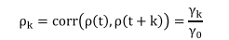
AUTOCORRELATON AND PERTIAL AUTOCORRELATION FUNCTION:
AUTOCORRELATION FUNCTION(ACF)
Autocorrelation is the correlation between two observations at different points in a time series. For example, values that are separated by an interval might have a strong positive or negative correlation. When these correlations are present, they indicate that past values influence the current value.
PACF stands for Partial Autocorrelation Function, which is a statistical tool used in time series analysis to identify the relationship between variables. Autocorrelation refers to the correlation between a time series and its own past values, while partial autocorrelation represents the correlation between a time series and its lagged values after removing the effects of the intermediate lags.
Autocorrelation function is defined by-

Slide 22

The ACF used to identify the order of a moving average (MA) model.
. The PACF used to identify the order of an
autoregressive (AR) model.
If both the ACF and PACF decay slowly, it may indicate the need for a mixed ARMA model.
Notes:
22 . Acf is used to identify the order of autocorrelation model And pacf is used to identify the order of a moving average model Baki same ARMA model er tuku pore dibi

Slide 23
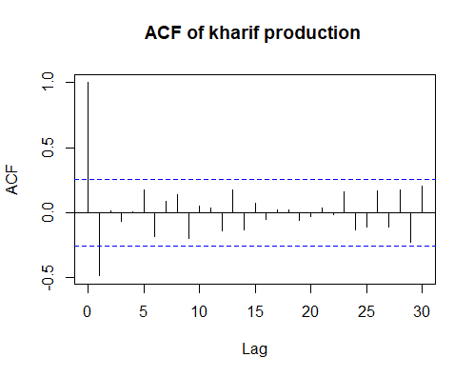
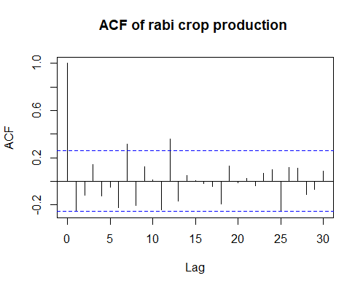

Data analysis:
According our dataset we get the ACF as follows-
For kharif and Rabi crop –
From visual inspection, the ACF is towards negative axis. Here lag1 is significant with $θ$being the negative values. It is MA(1).
From the diagram, here is Two significant spike lag6 and lag12 , so the data can be modelled as MA(2).
Notes:
HERE IS THE ACF PLOTS

Slide 24

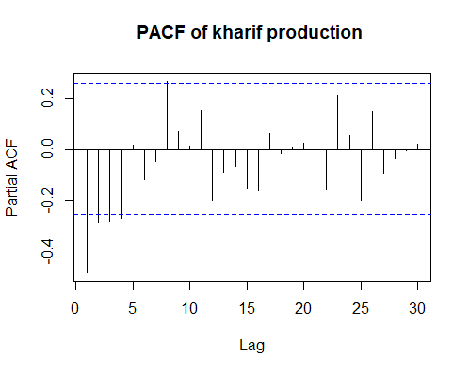
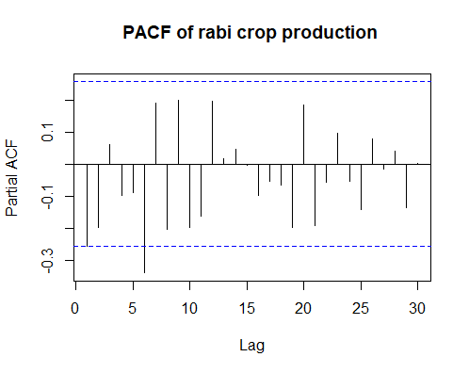
According our dataset we get the PACF as follows

Slide 25

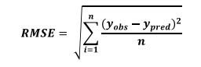
Model fitting on the data: -
ARIMA (Autoregressive Integrated Moving Average) is a widely used statistical model for time series analysis and forecasting. It combines three key elements: autoregression (AR), difference (I), and moving average (MA) to capture the underlying patterns and dependencies in the data.
ARIMA model combines the above three elements and is denoted as ARIMA (p, d, q). It can be used for forecasting future values of a time series, assuming that the underlying patterns and dependencies captured by the model remain unchanged.
Evaluating the model by checking the residuals for randomness and examining performance metrics such as the mean squared error (MSE). After that we calculate the RMSE (Root Mean Squared Error) of the predicted values with respect to the observed values in the testing data. From RMSE we can understand how good the fit is.

Slide 26
Data analysis: -
Here are the results of the ARIMA model
Series: y-kharif production
Summary of the model is given below -
arima(x = kharif production, order = c(0, 1, 1))
Coefficients:
ma1
-0.4376
s.e. 0.0958
Series: y-rabi production
Summary of the model is given below -
arima(x = y rabi production , order = c(1, 1, 2))
Coefficients:
ar1 ma1 ma2
-0.6821 0.5606 -0.2939
s.e. 0.1558 0.1681 0.1232

Slide 27

Training set error measures: Kharif Production ARIMA Model is mentioned below:-
Training set
ME | RMSE | MAE | MPE | MAPE | MASE | ACF1
2125.954 | 5474.994 | 4540.134 | 2.740958 | 8.056011 | 0.9831093 | -0.251324
Training set error measures: Rabi Production ARIMA Model is mentioned below:-
Training set
ME | RMSE | MAE | MPE | MAPE | MASE | ACF1
387.1899 | 1190.704 | 823.123 | 5.207842 | 11.35013 | 0.9058867 | -0.1489476
Interpretation: -
From inspection we can see that prediction of the testing data along with the observed values. As we can see that the RMSE is in both cases so we can say that the prediction of our testing data is not good enough.

Slide 28


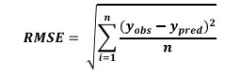
Holt Winters exponential smoothing:
we have applied the fitted Holt-Winters model to the testing data and predict the present values of the testing data. After that we calculate the RMSE (Root Mean Squared Error) of the predicted values with respect to the observed values in the testing data. From RMSE we can understand how good the fit is.
Data analysis: -
The summary of Holt Winters exponential smoothing for kharif crop production –
Holt Winters(x = kharif crop production , gamma = FALSE)
Smoothing parameters:
alpha: 0.3102772
beta: 0.3461922
gamma: FALSE
Coefficients:
[,1]
a 104514.945
b 2140.187
The summary of Holt Winters exponential smoothing for Rabi crop production –
HoltWinters(x =Rabi crop production , gamma = FALSE)
Smoothing parameters:
alpha: 0.6489699
beta: 0.04915577
gamma: FALSE
Coefficients:
[,1]
a 18143.5277
b 355.4084

Slide 29
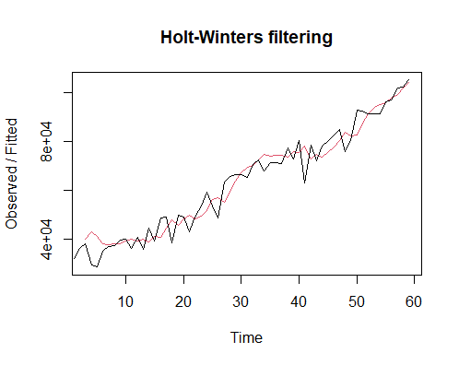
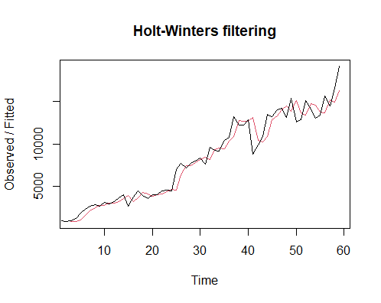
The graph is given bellow, the red line is smoothing line -
Interpretation: -
From the visual inspection we can see that prediction of the testing data along with the observed values, we can say that the prediction of our testing data is good enough. Now we will perform further process accordingly to predict the data.

Slide 30
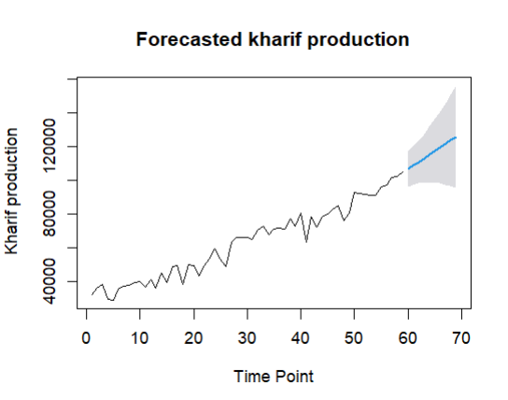
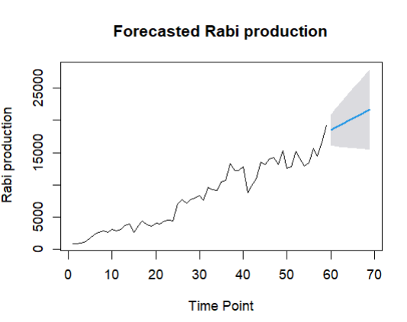
Forecasting :-
Here is the RMSE of seasonal ARIMA is greater than the RMSE of Holt-winters exponential smoothing.
So, we will predict the future crop production using Holt-winters exponential smoothing.
The forecasted production values and graphs from 2021 to 2030 is as follows:
Year | forecasted kharif crop production | forecasted rabi production
2021 | 106655.1 | 18498.94
2022 | 108795.3 | 18854.34
2023 | 110935.5 | 19209.75
2024 | 113075.7 | 19565.16
2025 | 115215.9 | 19920.57
2026 | 117356.1 | 20275.98
2027 | 119496.3 | 20631.39
2028 | 121636.4 | 20986.8
2029 | 123776.6 | 21342.2
2030 | 125916.8 | 21697.61

Slide 31
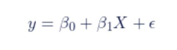
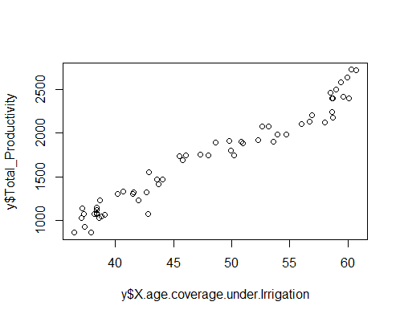
Simple Regression on total productivity and percentage coverage under irrigation:
Data Visualization
Regression analysis is used to analyze and determine the relationship between response variable and explanatory variable. The variable considered for analysis in this study is percentage cover under irrigation. total productivity is a dependent variable which depends on these factors.
The main data visualization tool used here is Scatterplot,
An increasing Trend found. Linear Trend may be fitted.
correlation between two variables is 0.976 (i.e highly correlated).

Slide 32
simple Linear regression fitting
we have fitted the model, got a summary of the model given here
Dependent Variable | Independent Variable | Regression Equation | t Value | R Squared | Decision
Total productivity | Area coverage under irrigation | y= -1351.80423 +63.73125x | -14.93 34.24 | Multiple R-squared: 0.9536, Adjusted R-squared: 0.9528 | X has an effect in the total productivity as the R square value is = 0.9528(quite high) so the regression line fit properly.
p-value: < 2.2e-16

Slide 33

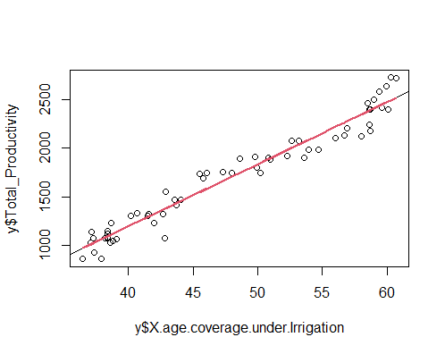
Here is the model fitted graph with abline –

Slide 34
Conclusion:-
Crop Production in India is an essential aspect that plays a significant role in the country’s economy and food security. Though the production of Kharif and Rabi crops has been increasing steadily over the years, the productivity of Indian agriculture is relatively low compared to the other countries. However, there are several challenges that Indian farmers has to face and it is essential to address these issues to improve the productivity and ensure sustainable agriculture. With the governments support and modern technology, Indian agriculture has the potential to become more productive and efficient, Which helps in improving the conditions of the Indian farmers and ensures the food security of the country ..

Slide 35
References : Books: Notes on Time Series Analysis provided by Dr. Saran Ishika Maiti (Asst. Prof. department of Statistics , Visva-Bharati University) Fundamental of Statistics(vol-1) by Gun Gupta Dasgupta Fundamental of Statistics(vol-2) by Gun Gupta Dasgupta Website: Geeks for Geeks Stack overflow Stack Exchange Slide model Wikipedia Unesco Image Source: Google, Bing, Internet Resource Software: R Console, R Studio, Microsoft Word, Excel, Power Point, Adobe Express, Google Slide
Notes:
Here are the references that we have used for the fulfilment of our project

Slide 36
Thank you

